Slide 1
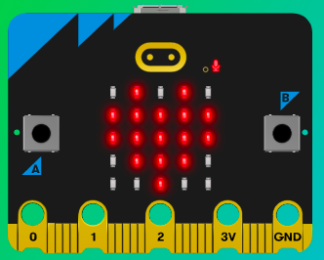
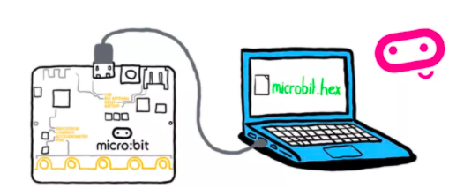
MicroMakers!
KIDS’ MAKER CLUB OF WASHINGTON, DC
Meet Up #22

Slide 2
REVIEW!
Notes:
LEDs, Buttons, Light Sensor

Slide 3
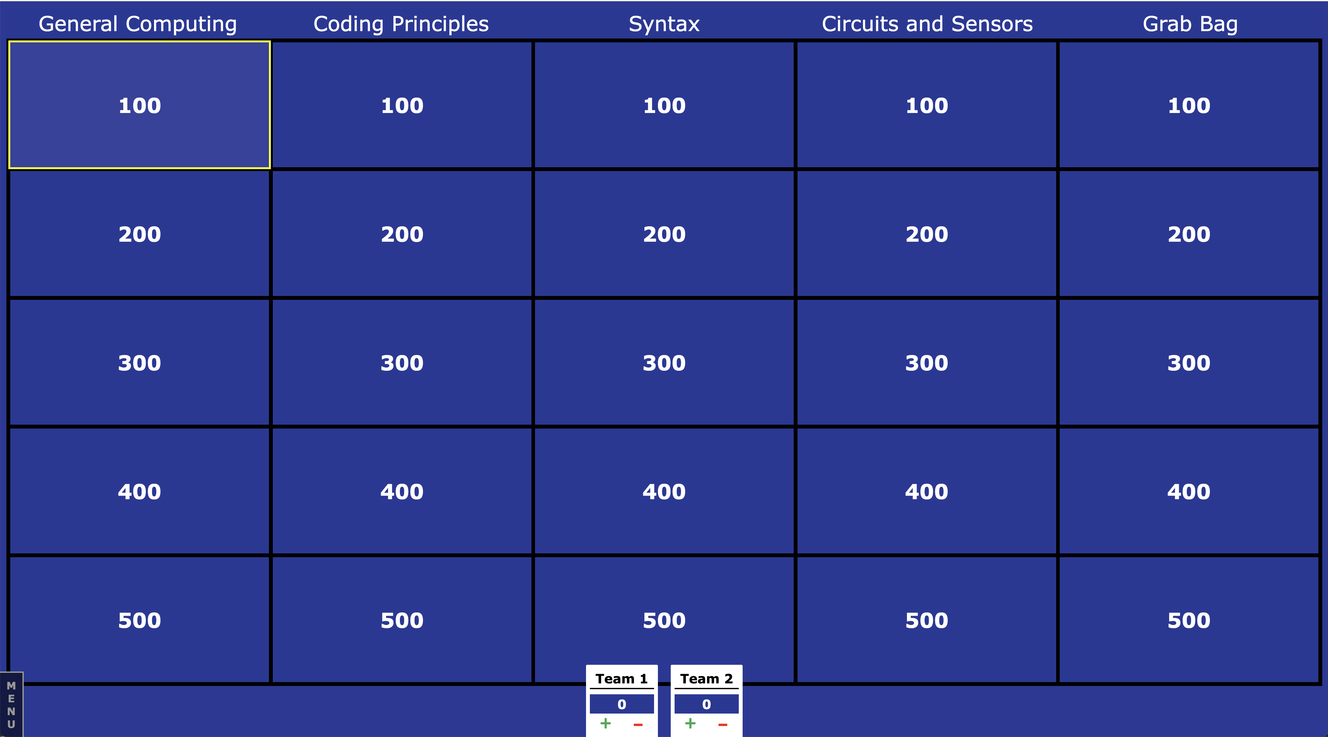

Slide 4
HOW COMPUTERS WORK
Inputs -> Outputs
The micro:bit helps us understand how computers work. When we type on our laptops or touch the screen on our phones, we’re using an input device. Inputs allow computers to sense things happening in the real world, so they can act on this and make something happen, usually on an output like a screen or headphones.

Slide 5

Notes:
The micro:bit helps us understand how computers work. When we type on our laptops or touch the screen on our phones, we’re using an input device. Inputs allow computers to sense things happening in the real world, so they can act on this and make something happen, usually on an output like a screen or headphones.

Slide 6

Notes:
In between the input and the output, there is the processor. This takes information from inputs like buttons, and makes something happen on outputs, like playing a song in your headphones.

Slide 7
HOW COMPUTERS WORK
Inputs -> Outputs
Examples of inputs on the micro:bit
Examples of outputs on the micro:bit

Slide 8
SENSORS
A type of input
The micro:bit helps us understand how sensors work. The micro:bit includes many sensors to detect information that our code can use to determine an output, like showing the number of steps you’ve taken on the LED display.

Slide 9


Slide 10


Slide 11


Slide 12
SENSORS
A type of input
Name a sensor on the micro:bit and what kind of program or project you might make that uses that sensor?

Slide 13
PROGRAMMING
Languages
Programming tells the computer how to take inputs and turn them into outputs.
We have learned three programming languages so far: Python, MakeCode, and Scratch.

Slide 14
PROGRAMMING
Languages
Describe a program you have written using each language: Python, MakeCode, and Scratch.
Which languages are best suited for:
Making a portable gadget that uses sensor input
Making an on-line video game you can share with your friends
Making an inter-active program that takes user text inputs and turns them into outputs.

Slide 15
PROGRAMMING
Components
Only three types of instructions are needed to write any program:
sequence: first do this, then do that
selection: IF such-and-such is the case, THEN do this, ELSE do that
repetition: WHILE such-and-such is the case, DO this.
Corrado Böhm and Giuseppe Jacopini's insight: there are only three ways of combining these actions (into more complex ones) that are needed in order for a computer to do "anything".^{[63]}

Slide 16
PROGRAMMING
Components
Only three types of instructions are needed to write any program:
sequence: first do this, then do that
selection: IF such-and-such is the case, THEN do this, ELSE do that
repetition: WHILE such-and-such is the case, DO this.

Slide 17
PROGRAMMING
Components
Only three types of instructions are needed to write any program:
sequence: first do this, then do that
selection: IF such-and-such is the case, THEN do this, ELSE do that
repetition: WHILE such-and-such is the case, DO this.

Slide 18
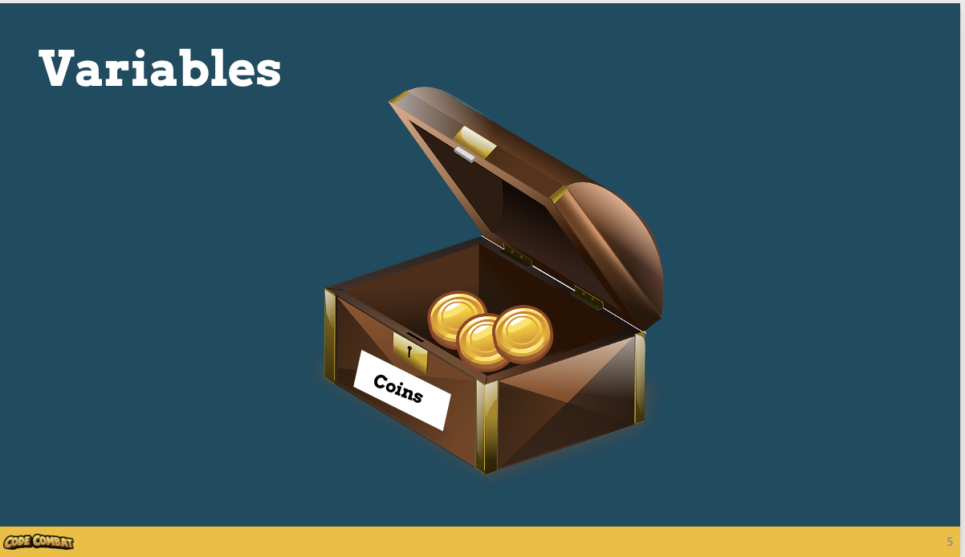

Slide 19
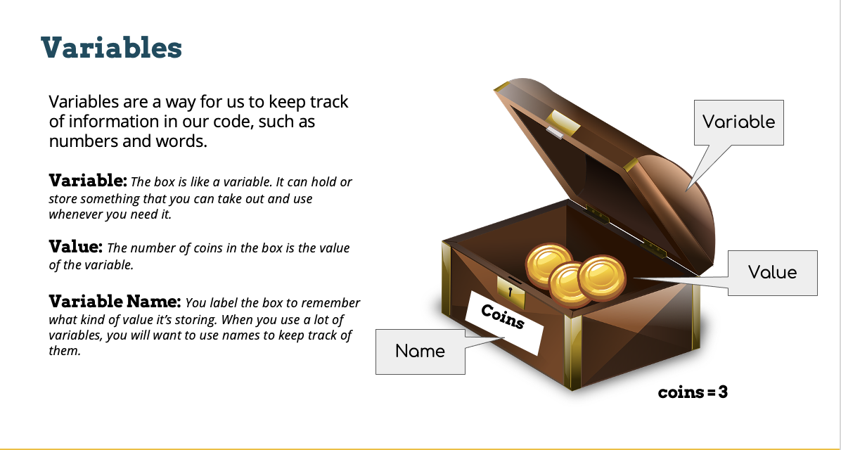

Slide 20
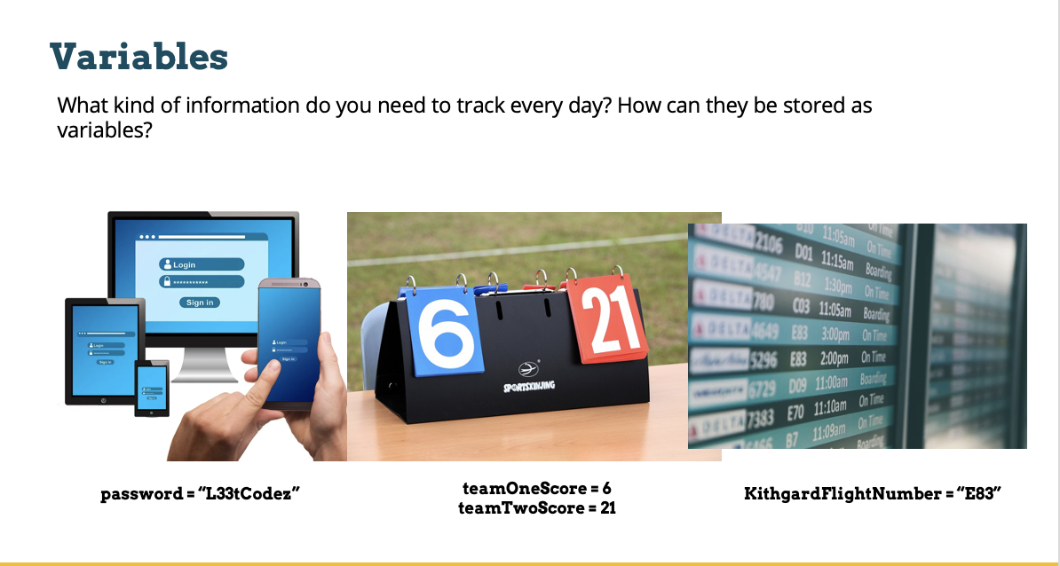

Slide 21
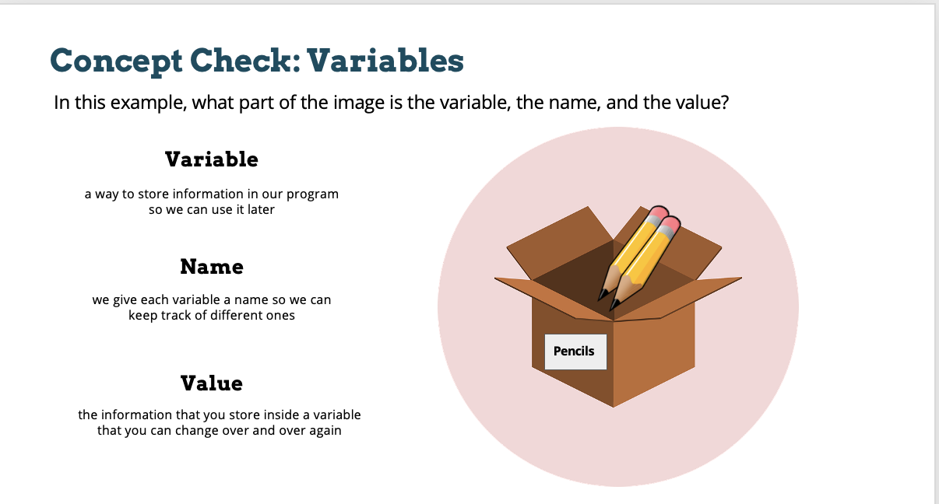

Slide 22
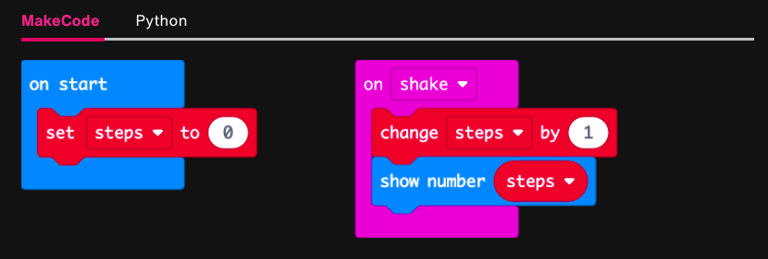
PROGRAMMING
Variables in MakeCode

Slide 23
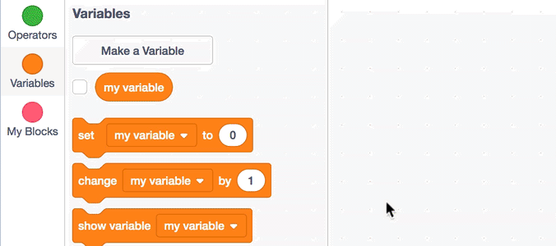
PROGRAMMING
Variables in Scratch

Slide 24
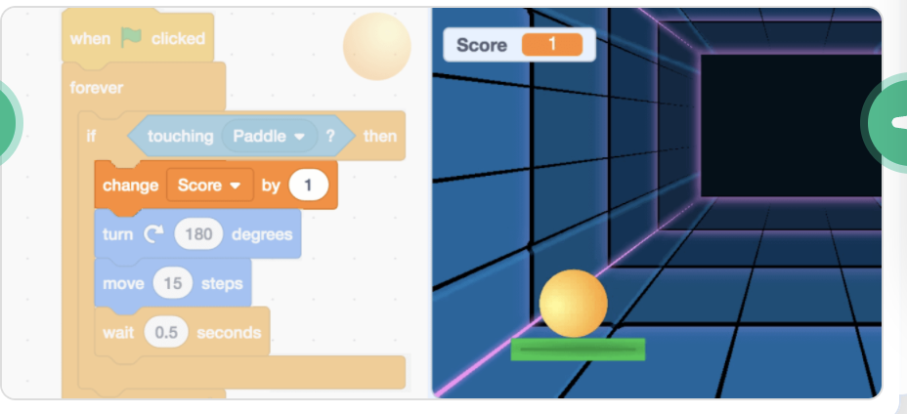
PROGRAMMING
Variables in Scratch

Slide 25
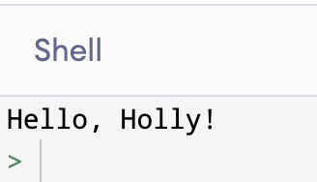
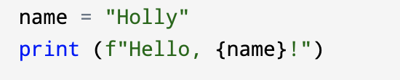
PROGRAMMING
Variables in Python

Slide 26
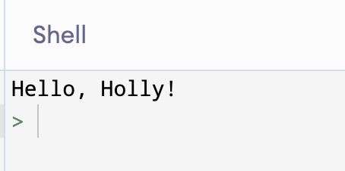
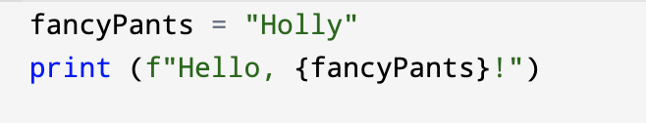
PROGRAMMING
Variables in Python

Slide 27
PROGRAMMING
Variables in Python: RULES!
To create a variable, first give it a name. There are rules for this:
Only letters – no numbers, symbols, or spaces allowed.
Camel case – first letter is lowercase. If combining to words, second is uppercase, like this: “firstSecond”
A variable can have a number or “string” value. If a “string”, must be in quotes. A string can be numbers, letters, or a combination.
In Python to assign a value to a variable, write an =.
Example:
food = “beans”
myAge = 12

Slide 28
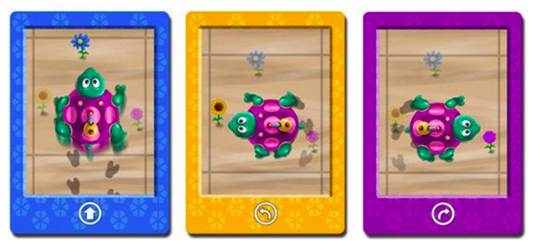
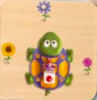
PROGRAMMING
Functions in Robot Turtles
Notes:
Using grid paper, pick a point and use pencil to trace the path of the robot turtle, using this program. What did you make?

Slide 29
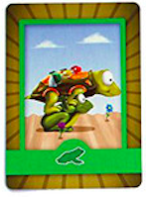
PROGRAMMING
Functions in Robot Turtles
=
Notes:
How could we re-write the same program using fewer cards (or, less code)? Function frogs! Now try following the program again. Did you get the same shape? The first program had 11 cards, and this one has 5 ☺

Slide 30
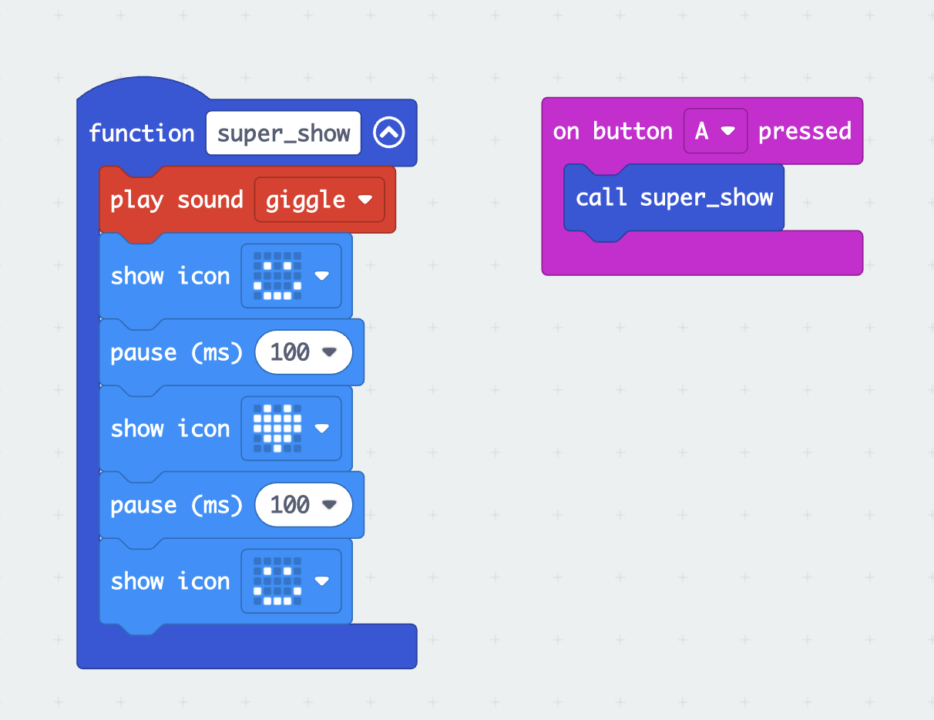
PROGRAMMING
Functions in MakeCode
Select “Make a Function” from the “Functions” menu (under “Advanced”)
Give your function a name so you can “call” it later.
Click “Done”
Give your function some things to do!
Call your function after an action, like pressing a button.

Slide 31
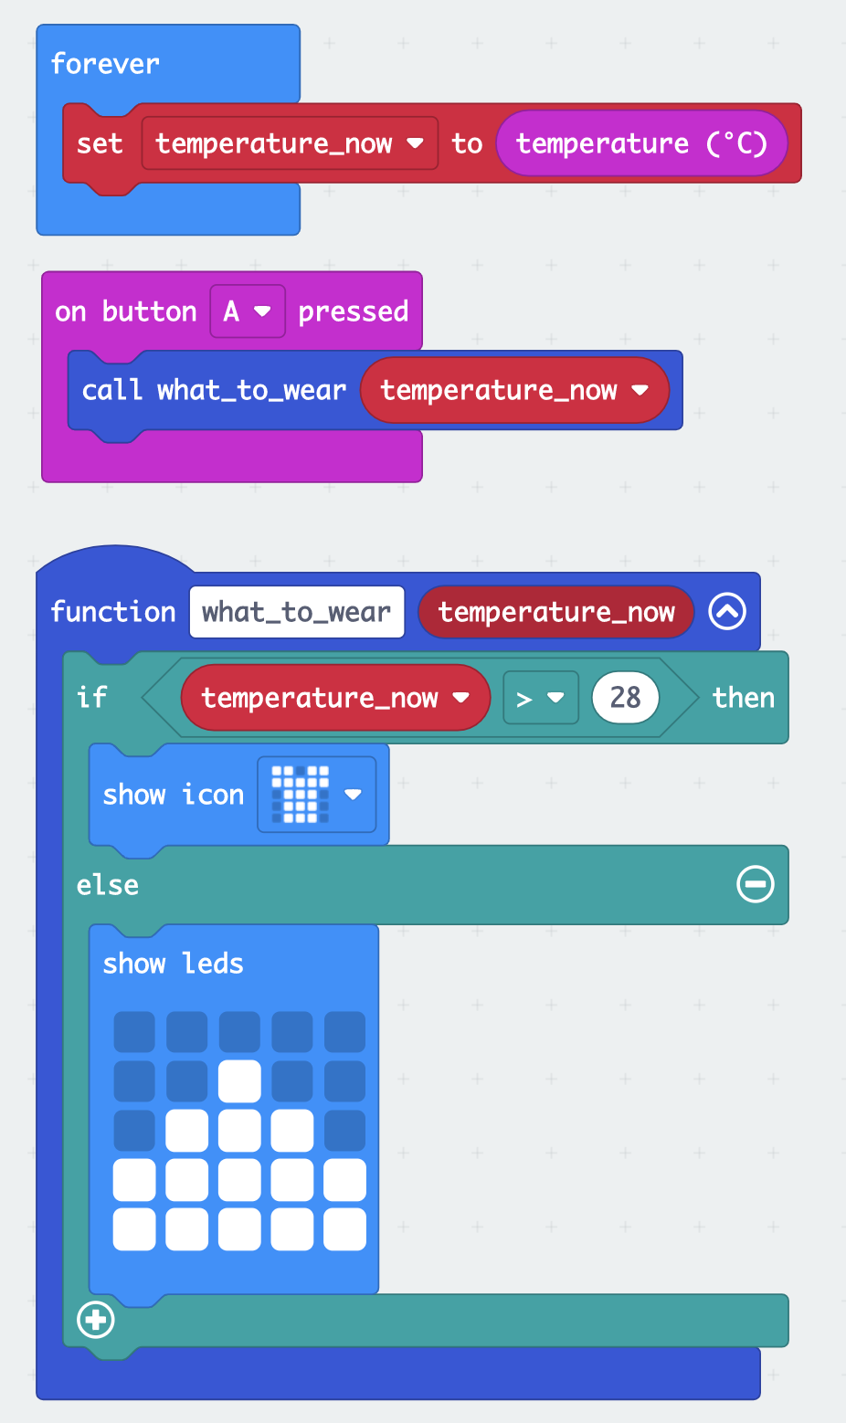
PROGRAMMING
Functions with Inputs

Slide 32
PROGRAMMING
Functions in Python
For each of the following functions, tell us (1) Its name; (2) What inputs go in between the parentheses; and (3) What it does with the inputs.
print ()
input ()
int ()

Slide 33
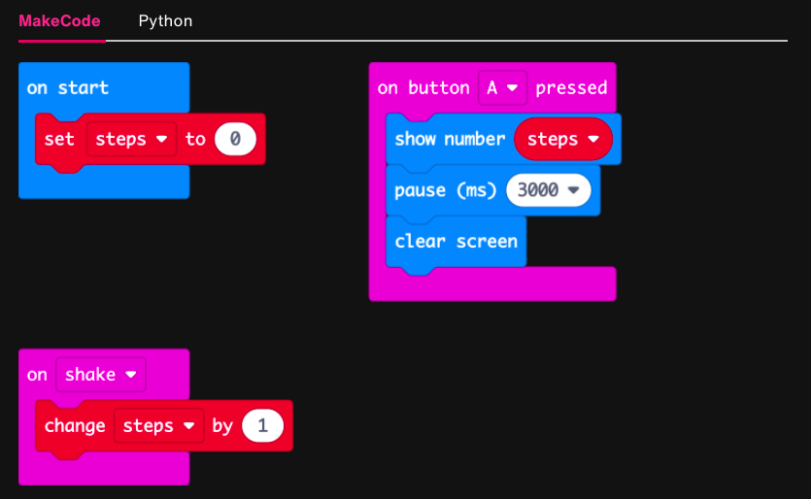
CODE READING

Slide 34
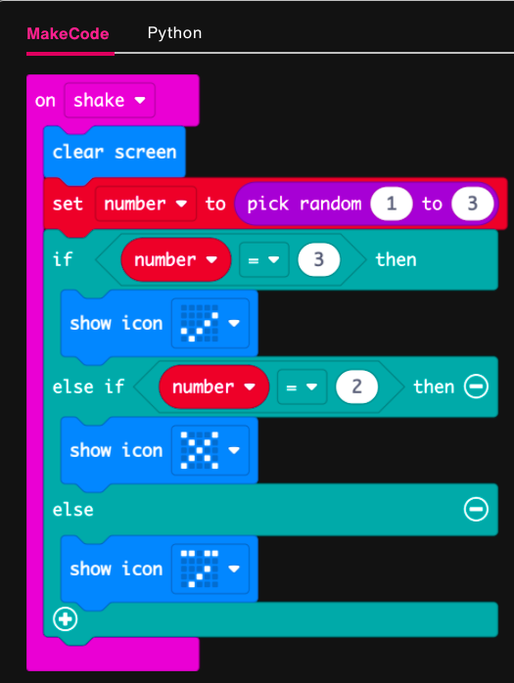
CODE READING

Slide 35
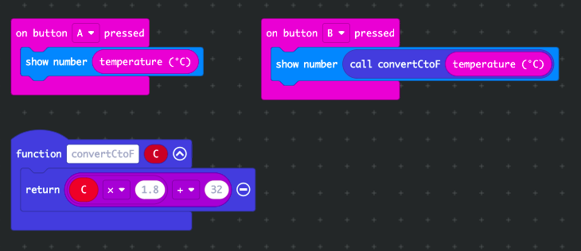
CODE READING

Slide 36
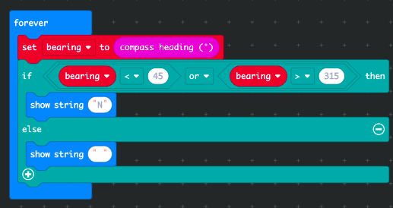
CODE READING

Slide 37
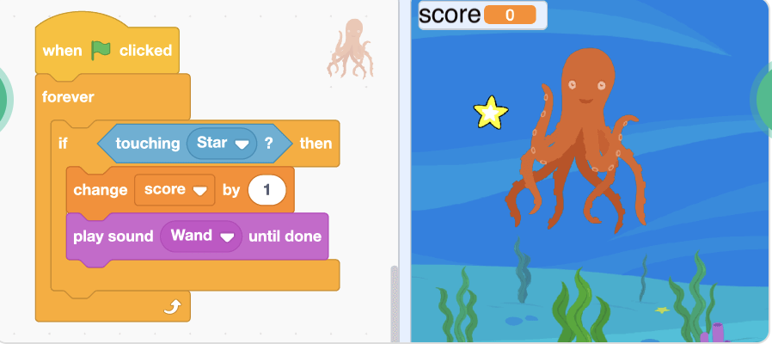
CODE READING

Slide 38
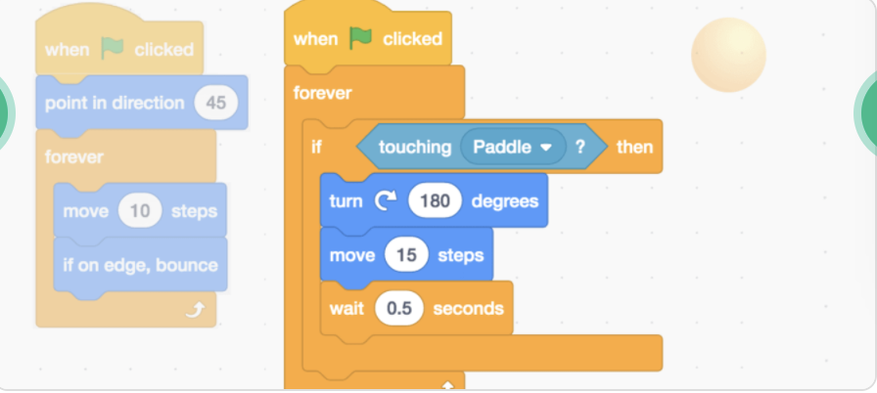
CODE READING

Slide 39
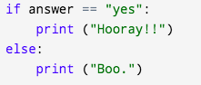
CODE READING

Slide 40
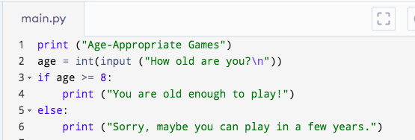
CODE READING

Slide 41
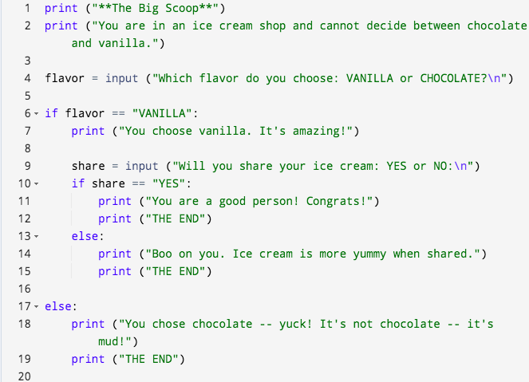
CODE READING

Slide 42
SYNTAX
Programming Grammar Rules
Syntax refers to the rules that define the structure of a language. Syntax in computer programming means the rules that control the structure of the symbols, punctuation, and words of a programming language.

Slide 43
SYNTAX
Python Syntax for Picky Computers
Variables
Debugging! Which of the following variable statements will not work, and why?
name = “bananas”
food = bananas
My score = 3
luv2Sail = “yes”

Slide 44
SYNTAX
Python Syntax for Picky Computers
Functions
Debugging! Which of the following functions will not work, and why?
print (“I love cream cheese.”)
print (“I love eggs, too.”) (“and ham.”)
Print (But broccoli is the best.)
print (“Sue’s favorite food is {food}.”)
food = input (“What is your favorite food?”)
print f(“Breakfast rocks.”)

Slide 45
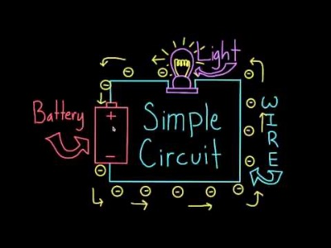
CIRCUITS
Follow the Electrons

Slide 46

CIRCUITS + PINS

Slide 47
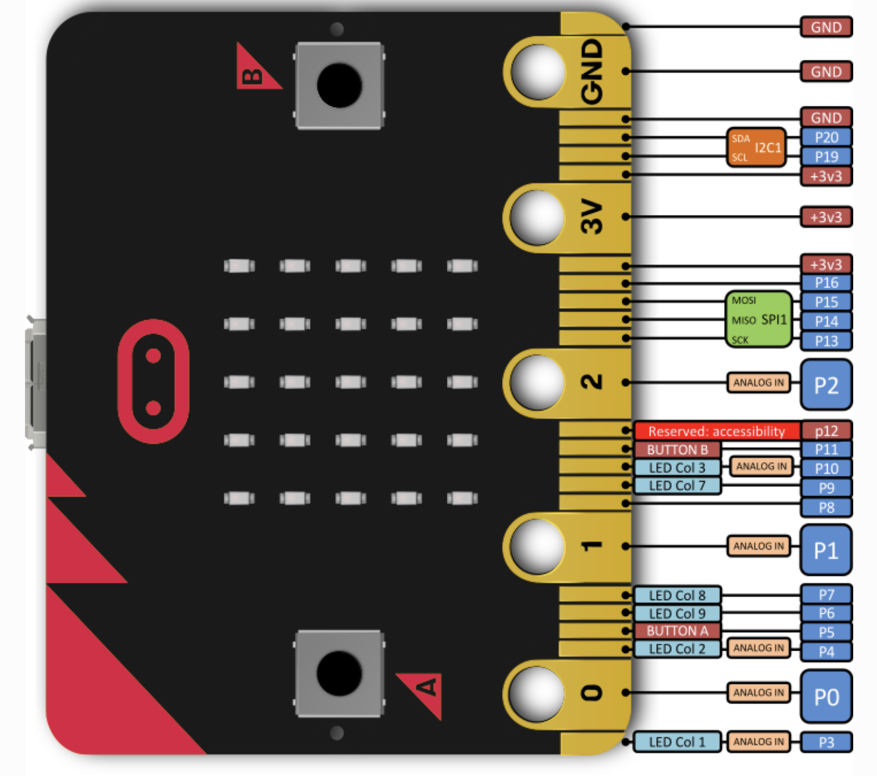
CIRCUITS + PINS

Slide 48

MATH + SCIENCE
Morse Code

Slide 49
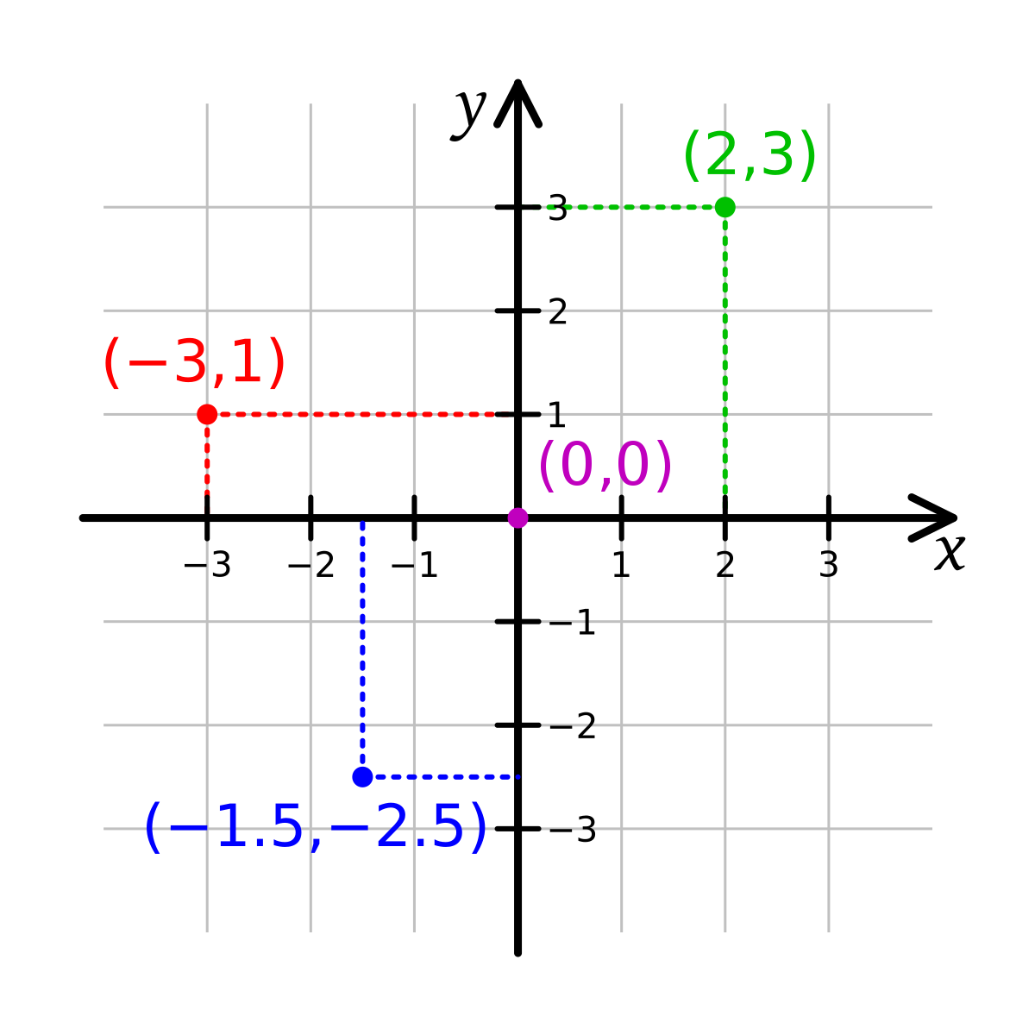
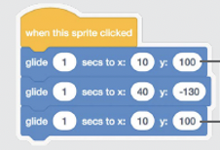
MATH + SCIENCE
Coordinate Plane

Slide 50
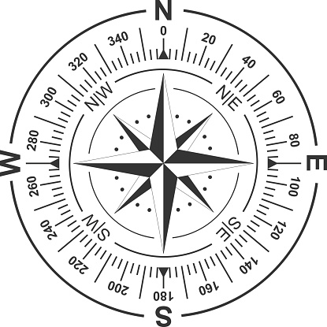
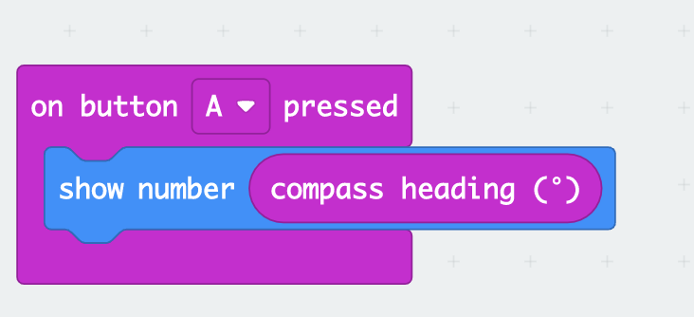
MATH + SCIENCE
Compass Degrees

Slide 51
MATH + SCIENCE
Radio!
Radio is a way to send electromagnetic signals over a long distance, to deliver information from one place to another. A machine that sends radio signals is called a transmitter, while a machine that "picks up" the signals is called a receiver. A machine that does both jobs is a "transceiver". When radio signals are sent out to many receivers at the same time, it is called a broadcast.

Slide 52


Slide 53
MATH + SCIENCE
Operators
Python already knows how to do basic math. What do these operators do?
+
-
/
*
**

Slide 54
TIME FOR JEOPARDY!
May the best team win!

Slide 56
https://jeopardylabs.com/play/micromaker-jeopardy

Slide 57
PRIZE CHART
Yay!
ITEM | # | PRICE / ITEM
Bubbles | 4 | $500
Bracelets (4-5 per pack) | 4 | $100
Ring Pops | 4 | $500
Galaxy Slime | 5 | $200
Mystery Eggs | 5 | $200
Mochi Rings | 10 | $100
Misc. | 2 | $300

Slide 58
TIME TO PUT AWAY OUR COMPUTERS
Neat and tidy, please!
Let’s leave this beautiful room as lovely as we found it!

Slide 59

UNTIL NEXT TIME….
MicroMakers!
Slides and Script: Holly Krambeck (learningpython64@gmail.com)

